Slide 2
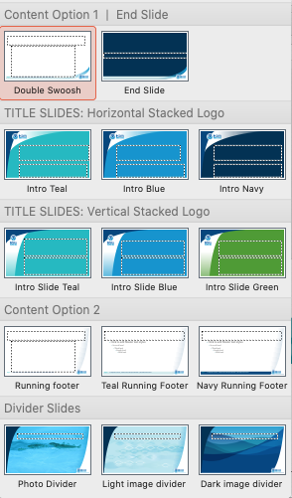
Available layouts
From the Home Tab:
Pick a layout from the New Slide dropdown menu shown to the left.
This menu also appears in the Layout dropdown menu so you can change slide layouts as you go.
Options:
There are two Title slide styles and two Content slide styles with multiple color options. Stick with one style throughout your presentation.
The background image in Title and Divider Slides can be changed in the Format Background tab.
Notes:
NOTE: The slide Transition is set to PUSH from below. You can remove or change transitions on the Transitions tab.

